Slide 1
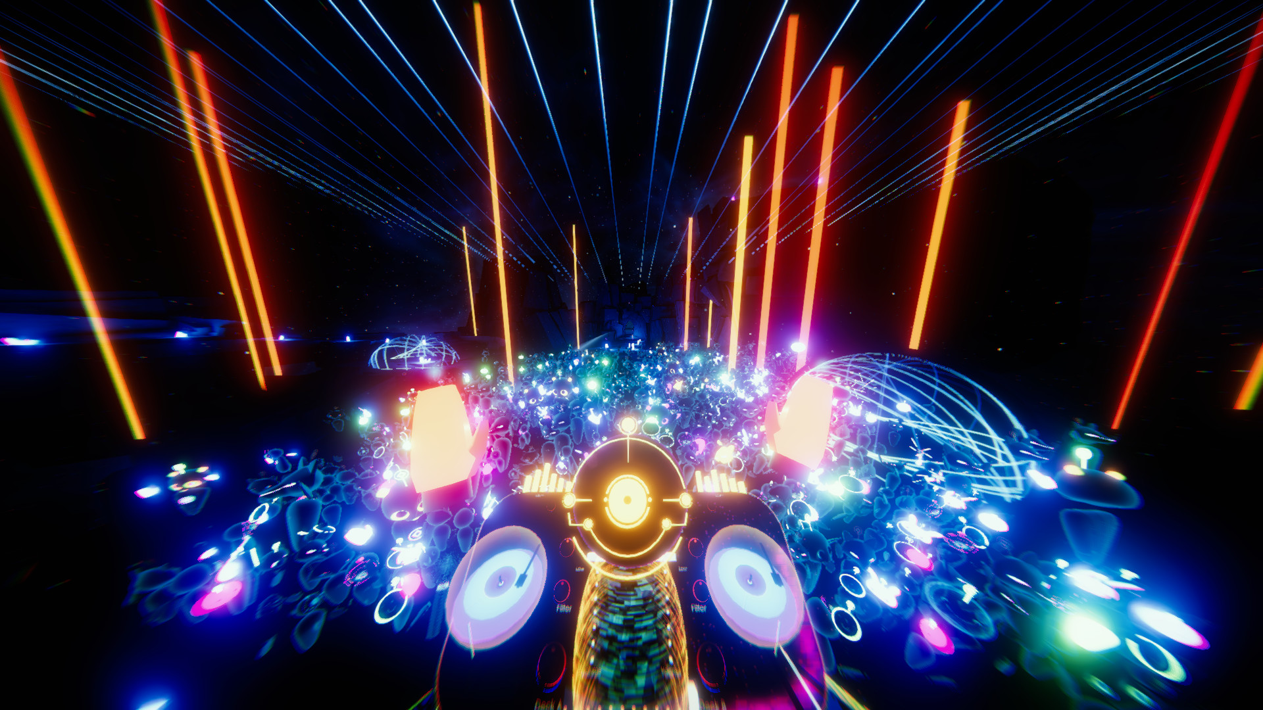
A Taxonomy of Sounds for Virtual Reality
Dhruv “DJ” Jain, Sasa Junuzovic, Eyal Ofek, Mike Sinclair, John Porter,
Chris Yoon, Swetha Machanavajhala, Meredith Ringel Morris
University of Washington, Microsoft Research
Notes:
Hello! I am DJ from the University of Washington. But this work was done as part of my summer internship at Microsoft Research, looking at taxonomy of sounds in virtual reality.

Slide 2
Notes:
So, sound is a very critical component of the VR world. It can provide critical information such as [slide] approaching enemy footsteps, can increase realism such as [slide] through a wind blowing sound, or add aesthetics to a VR app such as [slide] using water spill sounds.
However, [slide]

Slide 3
Notes:
So, sound is a very critical component of the VR world. It can provide critical information such as [slide] approaching enemy footsteps, can increase realism such as [slide] through a wind blowing sound, or add aesthetics to a VR app such as [slide] using water spill sounds.
However, [slide]

Slide 4
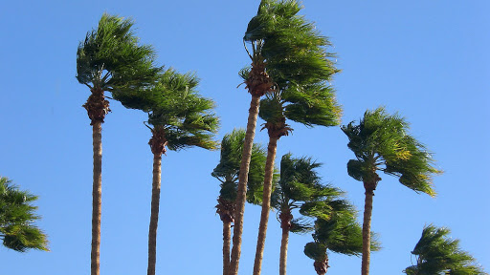
Notes:
So, sound is a very critical component of the VR world. It can provide critical information such as [slide] approaching enemy footsteps, can increase realism such as [slide] through a wind blowing sound, or add aesthetics to a VR app such as [slide] using water spill sounds.
However, [slide]

Slide 5
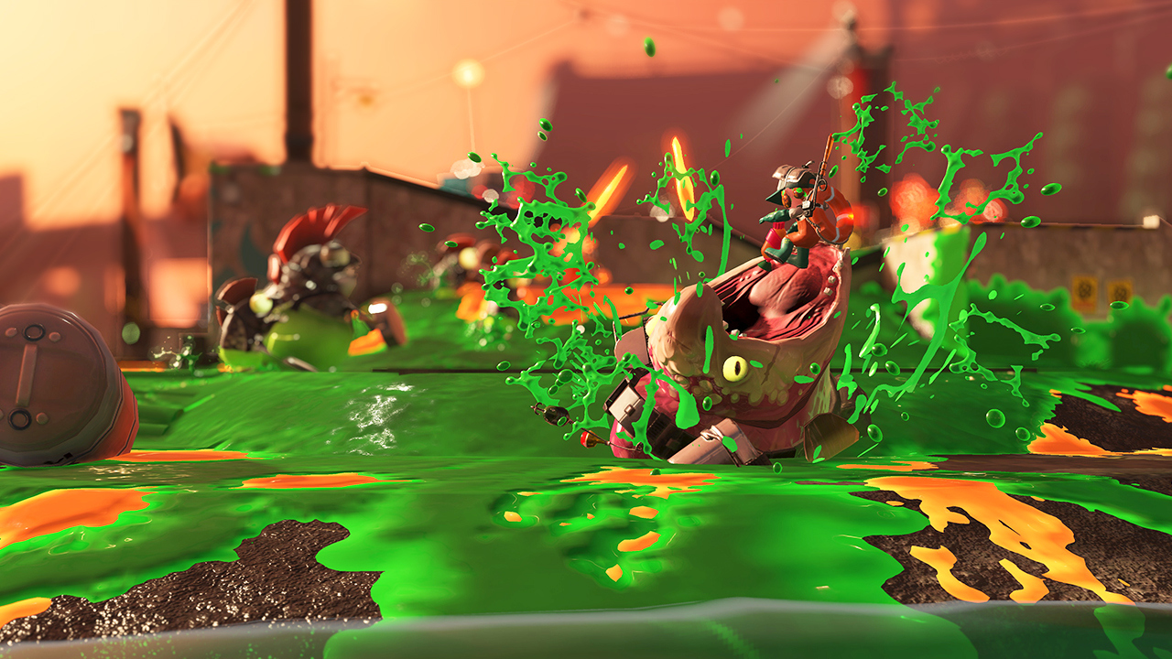
Notes:
So, sound is a very critical component of the VR world. It can provide critical information such as [slide] approaching enemy footsteps, can increase realism such as [slide] through a wind blowing sound, or add aesthetics to a VR app such as [slide] using water spill sounds.
However, [slide]

Slide 6
For many deaf and hard-of-hearing (DHH) people, these sounds and the information they convey may not be accessible, which may limit their VR experience.
Notes:
For many deaf and hard of hearing people, these sounds and the information they convey may not be accessible, which may limit their VR experience. They may miss critical cues in games or may not feel fully immersed.
This is why our [slide] bigger research project is exploring [slide] how to make sounds in VR accessible to DHH people. [pause] But, before we talk about accessibility, we need to understand… [slide]

Slide 7
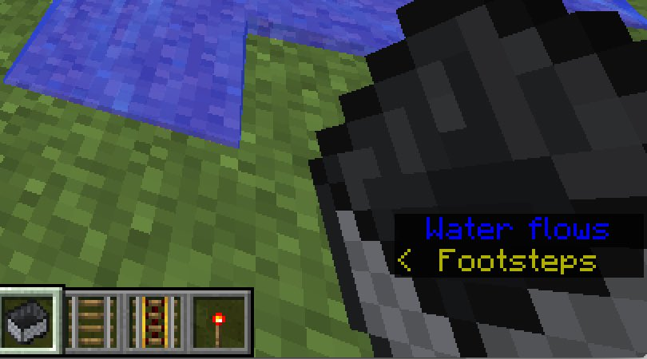
Big Research Goal
How to make sounds in VR
accessible to DHH people?
Notes:
For many deaf and hard of hearing people, these sounds and the information they convey may not be accessible, which may limit their VR experience. They may miss critical cues in games or may not feel fully immersed.
This is why our [slide] bigger research project is exploring [slide] how to make sounds in VR accessible to DHH people. [pause] But, before we talk about accessibility, we need to understand… [slide]

Slide 8
This Paper’s Focus
What all sounds are there in VR and
how are these sounds designed?
Notes:
…What all sounds are there in VR and how are these sounds designed? This is the [slide] focus of this paper and my talk.
Specifically, I will present the [slide] design and evaluation of a novel taxonomy intended to organize and discuss sounds in VR… [slide] with a long-term goal to make them accessible to DHH people.
[don’t slide] Let’s first discuss some related work.
[slide]

Slide 9
Design and evaluation of a
novel taxonomy to organize and discuss VR sounds.
…with a long-term goal to make VR accessible to DHH people.
Notes:
…What all sounds are there in VR and how are these sounds designed? This is the [slide] focus of this paper and my talk.
Specifically, I will present the [slide] design and evaluation of a novel taxonomy intended to organize and discuss VR sounds… [slide] with a long-term goal to make VR accessible to DHH people.
[slide]

Slide 10
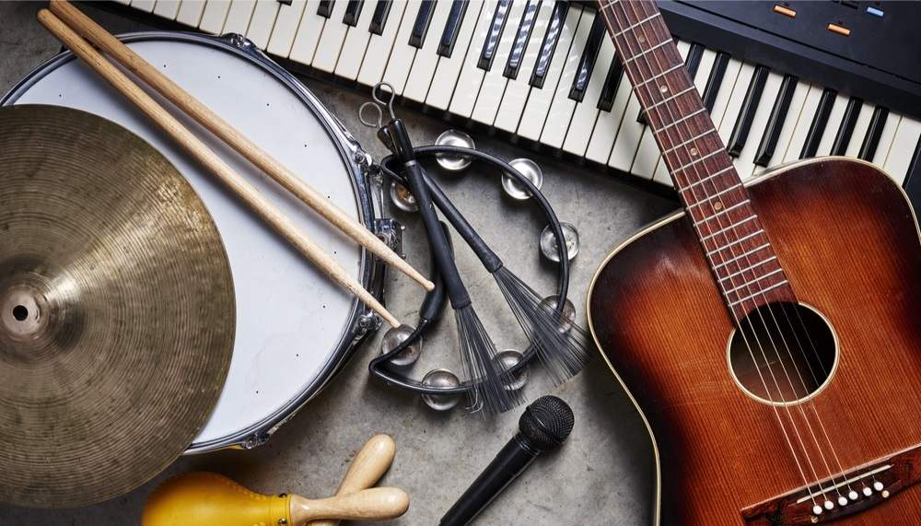
Most prior taxonomies focus on organizing real-world sounds…
Notes:
Most prior taxonomies focus on organizing real-world sounds such as [slide] urban sounds, [slide] animal calls, and [slide] music.
[don’t slide] But, VR also includes many synthetic sounds and exaggerated real-world sounds, and so the real-world sound taxonomies cannot be used for VR. Which is why we turned to… [slide]

Slide 11
We investigated the sound taxonomies for 2D video games and films.
Notes:
investigating the sounds taxonomies for 2D video games and films.
However, [slide] we found that they have several limitations. First, these taxonomies either cover the [slide] source or the intended functionality of the sounds but not both. [don’t slide] Past work has shown that if you only cover one dimension, it could be lead to ambiguity in certain nuanced meanings of sounds. For example, [slide] a character speech which is a source of the sound, can either represent [slide] critical information in a game such as [slide] a narrator’s speech [pause]
[don’t slide] …or it could be meant to [slide] increase realism, as in crowd noise [don’t slide] So, in this example, the same source could have two different intents, but past taxonomies do not account for both. [slide]

Slide 12
We investigated the sound taxonomies for 2D video games and films.
However, we found several limitations.
Either cover source or intent of sounds, not both
Notes:
investigating the sounds taxonomies for 2D video games and films.
However, [slide] we found that they have several limitations. First, these taxonomies either cover the [slide] source or the intended functionality of the sounds but not both. [don’t slide] Past work has shown that if you only cover one dimension, it could be lead to ambiguity in certain nuanced meanings of sounds. For example, [slide] a character speech which is a source of the sound, can either represent [slide] critical information in a game such as [slide] a narrator’s speech [pause]
[don’t slide] …or it could be meant to [slide] increase realism, as in crowd noise [don’t slide] So, in this example, the same source could have two different intents, but past taxonomies do not account for both. [slide]

Slide 13
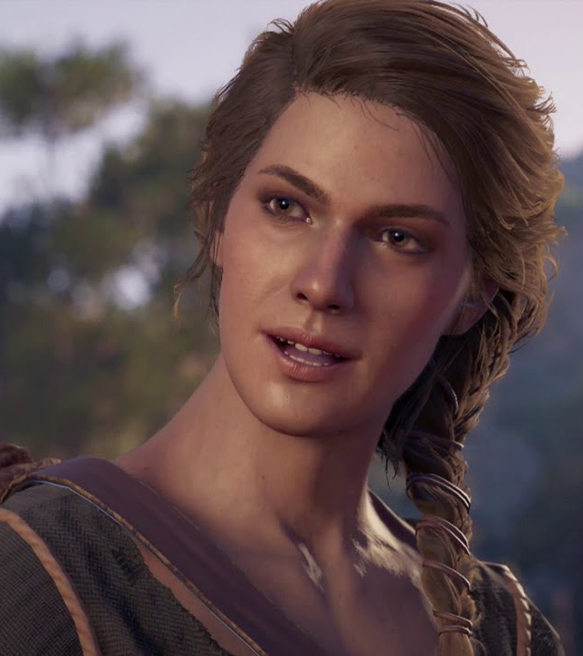
Source: character speech
Intent: critical information
Intent: increasing realism
Where is the road to Sami?
Notes:
investigating the sounds taxonomies for 2D video games and films.
However, [slide] we found that they have several limitations. First, these taxonomies either cover the [slide] source or the intended functionality of the sounds but not both. [don’t slide] Past work has shown that if you only cover one dimension, it could be lead to ambiguity in certain nuanced meanings of sounds. For example, [slide] a character speech which is a source of the sound, can either represent [slide] critical information in a game such as [slide] a narrator’s speech [pause]
[don’t slide] …or it could be meant to [slide] increase realism, as in crowd noise [don’t slide] So, in this example, the same source could have two different intents, but past taxonomies do not account for both. [slide]

Slide 14
We investigated the sound taxonomies for 2D video games and films.
However, we found several limitations.
Either cover source or intent of sounds, not both
Do not account for 3D spatial variations in VR
Notes:
[pause]
Then there are other limitations as well. Like, for example, prior taxonomies are meant for 2D games and movies and [slide] do not account for 3D spatial variations in VR.
[don’t slide] And so, we needed a new taxonomy for VR sounds.

Slide 15
To Build and Evaluate our Taxonomy…
Study 1
Interview with 10 VR sound designers to develop our taxonomy.
Evaluation of our taxonomy by classifying sounds across 33 VR apps.
Study 2
Notes:
To build and evaluate this new taxonomy, we performed two studies. [slide] Study 1 included [slide] interviews with 10 VR sound designers to develop our taxonomy. [slide]And In Study 2, [slide] we evaluated our taxonomy by classifying sounds across 33 VR apps.
[don’t slide] In this talk, I will focus on results from these two studies. Let’s start with the first one.
[slide]

Slide 16
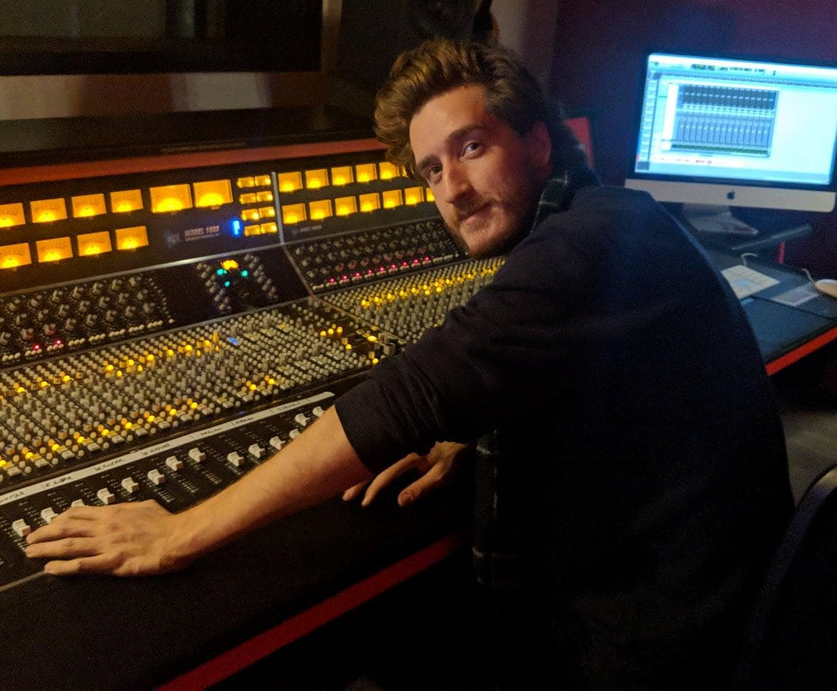
Study 1
Goal
To explore different ways in which sound are used or represented in VR.
Procedure
Interviewed 10 VR sound designers on their experience of designing sounds for 2-3 VR apps.
Analysis
Using open, axial, and selective coding, we developed our taxonomy of sounds and other findings related to sound design in VR.
Notes:
The [slide] goal of study 1 was to [slide] explore different ways in which sounds are used or represented in VR.
[slide] Our procedure included [slide] interviews with 10 VR sound designers on their experience of designing sounds for 2-3 commercially available VR apps.
[slide] Using open, axial, and selective coding, we articulated our taxonomy of sounds and other findings related to sound design in VR.
[don’t slide] Let’s discuss some highlights. [slide]

Slide 17
No agreed upon terminology or common language for describing sounds in VR!
Study 1 Findings
Notes:
Sound designers described that there is no agreed upon terminology or common language for describing sounds in VR, which makes it difficult to collaborate with others… as described by one of our participants [slide]

Slide 18
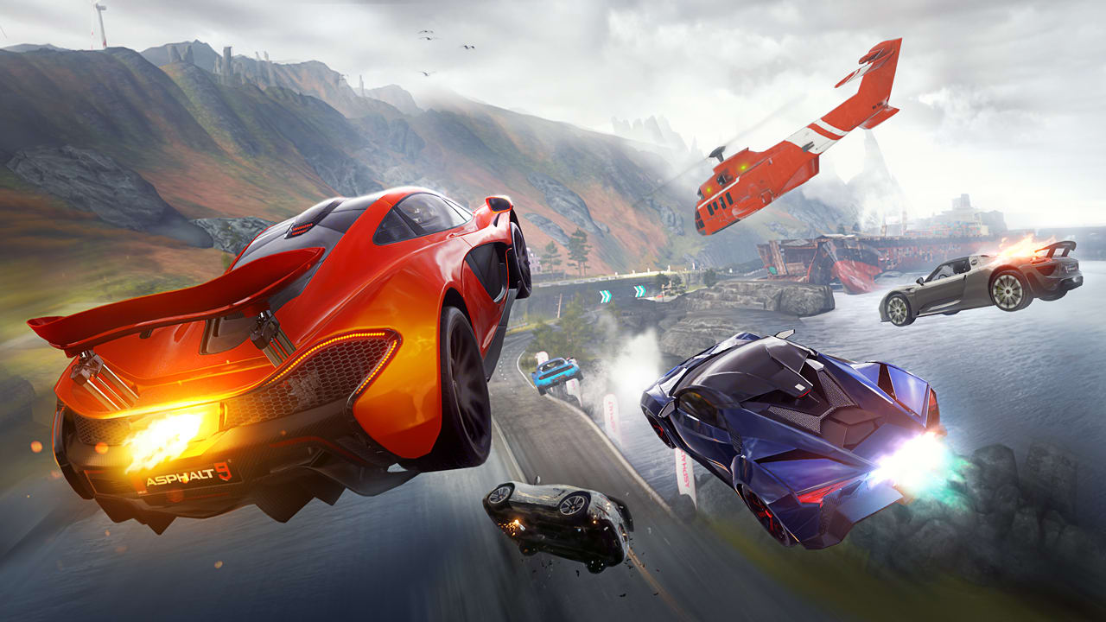
“We were trying to describe the sound when a car engine sounded weird... And we described it as a “chuddering” sound. It sounded like an onomatopoeia for it, but that is it. No one else is going to know it. [...] That’s how a lot of audio stuff goes by. People name different things. They don’t have a common language.”
- P8
Study 1 Findings
Notes:
[read slide]
[after reading, don’t slide] But the good news is that through multiple rounds of open, axial, and selective coding, we were able to articulate a taxonomy of sounds that all designers agreed with. [slide]

Slide 19
Our Taxonomy Of VR Sounds
Sound Source
Sound Intent
Study 1 Findings
Notes:
[pause] This taxonomy contains two dimensions: [slide] sound source and [slide] sound intent.
[slide]

Slide 20
Our Taxonomy Of VR Sounds
Sound Source
Sound Intent
Localized speech (e.g., a human speaking)
Non-localized speech (e.g., a narrator)
Inanimate objects (e.g., weapons)
Animate sounds (e.g., footsteps)
Interaction sounds (e.g., punching an enemy)
Point ambience (e.g., river on one side of a player)
Surrounding ambience (e.g., a crowd)
Notification sounds (e.g., low on ammunition)
Music
Sounds for critical information (e.g., enemy footsteps)
Sounds for increasing realism (e.g., river flowing)
Sounds for rhythm or movement (e.g., an exercise game)
Sounds for affective state (e.g., stressful sounds)
Sounds for aesthetics/decoration (e.g., a whoosh sound)
Sounds for non-critical interaction (e.g., touching a menu)
Study 1 Findings
Notes:
[don’t slide] Sound source represents the source that produced the sound such as a character or an object. Within this dimension, we have [slide] nine categories that describe various localized and non-localized sources of sounds.
[don’t slide] Some of these categories may appear to overlap such as interaction and notification sounds, but we have tested that are all mutually exclusive. [pause]
[don’t slide] Beyond the source, it’s also important to capture the intent of the sounds, since—as I described earlier— sound from the same source may have different intents. So, we have a second dimension, called [slide] sound intent, containing [slide] six categories such as sounds for conveying critical information or increasing realism.
[slide]

Slide 21
Our Taxonomy Of VR Sounds
Sound Source
Sound Intent
Localized speech (e.g., a human speaking)
Non-localized speech (e.g., a narrator)
Inanimate objects (e.g., weapons)
Animate sounds (e.g., footsteps)
Interaction sounds (e.g., punching an enemy)
Point ambience (e.g., river on one side of a player)
Surrounding ambience (e.g., a crowd)
Notification sounds (e.g., low on ammunition)
Music
Sounds for critical information (e.g., enemy footsteps)
Sounds for increasing realism (e.g., river flowing)
Sounds for rhythm or movement (e.g., an exercise game)
Sounds for affective state (e.g., stressful sounds)
Sounds for aesthetics/decoration (e.g., a whoosh sound)
Sounds for non-critical interaction (e.g., touching a menu)
Study 1 Findings
Notes:
[naturalize] The richness of the taxonomy comes from the fact that is covers both the [slide] source and the [slide] intent of the sounds, is able to represent the sounds that originate from the VR world such as [slide] interaction sounds and the sounds that are played in the background like [slide] music, and that it represents both the 3D localized [slide] and non-localized [slide] sources of sounds.
[slide]

Slide 22
Our Taxonomy Of VR Sounds
Sound Source
Sound Intent
Localized speech (e.g., a human speaking)
Non-localized speech (e.g., a narrator)
Inanimate objects (e.g., weapons)
Animate sounds (e.g., footsteps)
Interaction sounds (e.g., punching an enemy)
Point ambience (e.g., river on one side of a player)
Surrounding ambience (e.g., a crowd)
Notification sounds (e.g., low on ammunition)
Music
Sounds for critical information (e.g., enemy footsteps)
Sounds for increasing realism (e.g., river flowing)
Sounds for rhythm or movement (e.g., an exercise game)
Sounds for affective state (e.g., stressful sounds)
Sounds for aesthetics/decoration (e.g., a whoosh sound)
Sounds for non-critical interaction (e.g., touching a menu)
Study 1 Findings
Notes:
[emphasize] The richness of the taxonomy comes from the fact that is covers both the [slide] source and the [slide] intent of the sounds, is able to represent the sounds that originate from the VR world such as [slide] interaction sounds and the sounds that are played in the background like [slide] music, and that it represents both the 3D localized [slide] and non-localized [slide] sources of sounds.
[slide]

Slide 23
Our Taxonomy Of VR Sounds
Sound Source
Sound Intent
Localized speech (e.g., a human speaking)
Non-localized speech (e.g., a narrator)
Inanimate objects (e.g., weapons)
Animate sounds (e.g., footsteps)
Interaction sounds (e.g., punching an enemy)
Point ambience (e.g., river on one side of a player)
Surrounding ambience (e.g., a crowd)
Notification sounds (e.g., low on ammunition)
Music
Sounds for critical information (e.g., enemy footsteps)
Sounds for increasing realism (e.g., river flowing)
Sounds for rhythm or movement (e.g., an exercise game)
Sounds for affective state (e.g., stressful sounds)
Sounds for aesthetics/decoration (e.g., a whoosh sound)
Sounds for non-critical interaction (e.g., touching a menu)
Study 1 Findings
Notes:
[emphasize] The richness of the taxonomy comes from the fact that is covers both the [slide] source and the [slide] intent of the sounds, is able to represent the sounds that originate from the VR world such as [slide] interaction sounds and the sounds that are played in the background like [slide] music, and that it represents both the 3D localized [slide] and non-localized [slide] sources of sounds.
[slide]

Slide 24
Our Taxonomy Of VR Sounds
Sound Source
Sound Intent
Localized speech (e.g., a human speaking)
Non-localized speech (e.g., a narrator)
Inanimate objects (e.g., weapons)
Animate sounds (e.g., footsteps)
Interaction sounds (e.g., punching an enemy)
Point ambience (e.g., river on one side of a player)
Surrounding ambience (e.g., a crowd)
Notification sounds (e.g., low on ammunition)
Music
Sounds for critical information (e.g., enemy footsteps)
Sounds for increasing realism (e.g., river flowing)
Sounds for rhythm or movement (e.g., an exercise game)
Sounds for affective state (e.g., stressful sounds)
Sounds for aesthetics/decoration (e.g., a whoosh sound)
Sounds for non-critical interaction (e.g., touching a menu)
Study 1 Findings
Notes:
[emphasize] The richness of the taxonomy comes from the fact that is covers both the [slide] source and the [slide] intent of the sounds, is able to represent the sounds that originate from the VR world such as [slide] interaction sounds and the sounds that are played in the background like [slide] music, and that it represents both the 3D localized [slide] and non-localized [slide] sources of sounds.
[slide]

Slide 25
Our Taxonomy Of VR Sounds
Sound Source
Sound Intent
Localized speech (e.g., a human speaking)
Non-localized speech (e.g., a narrator)
Inanimate objects (e.g., weapons)
Animate sounds (e.g., footsteps)
Interaction sounds (e.g., punching an enemy)
Point ambience (e.g., river on one side of a player)
Surrounding ambience (e.g., a crowd)
Notification sounds (e.g., low on ammunition)
Music
Sounds for critical information (e.g., enemy footsteps)
Sounds for increasing realism (e.g., river flowing)
Sounds for rhythm or movement (e.g., an exercise game)
Sounds for affective state (e.g., stressful sounds)
Sounds for aesthetics/decoration (e.g., a whoosh sound)
Sounds for non-critical interaction (e.g., touching a menu)
Study 1 Findings
Notes:
[emphasize] The richness of the taxonomy comes from the fact that is covers both the [slide] source and the [slide] intent of the sounds, is able to represent the sounds that originate from the VR world such as [slide] interaction sounds and the sounds that are played in the background like [slide] music, and that it represents both the 3D localized [slide] and non-localized [slide] sources of sounds.
[slide]

Slide 26
Our Taxonomy Of VR Sounds
Sound Source
Sound Intent
Localized speech (e.g., a human speaking)
Non-localized speech (e.g., a narrator)
Inanimate objects (e.g., weapons)
Animate sounds (e.g., footsteps)
Interaction sounds (e.g., punching an enemy)
Point ambience (e.g., river on one side of a player)
Surrounding ambience (e.g., a crowd)
Notification sounds (e.g., low on ammunition)
Music
Sounds for critical information (e.g., enemy footsteps)
Sounds for increasing realism (e.g., river flowing)
Sounds for rhythm or movement (e.g., an exercise game)
Sounds for affective state (e.g., stressful sounds)
Sounds for aesthetics/decoration (e.g., a whoosh sound)
Sounds for non-critical interaction (e.g., touching a menu)
Study 1 Findings
Notes:
[emphasize] The richness of the taxonomy comes from the fact that is covers both the [slide] source and the [slide] intent of the sounds, is able to represent the sounds that originate from the VR world such as [slide] interaction sounds and the sounds that are played in the background like [slide] music, and that it represents both the 3D localized [slide] and non-localized [slide] sources of sounds.
[slide]

Slide 27
Our Taxonomy Of VR Sounds
Sound Source
Sound Intent
Localized speech (e.g., a human speaking)
Non-localized speech (e.g., a narrator)
Inanimate objects (e.g., weapons)
Animate sounds (e.g., footsteps)
Interaction sounds (e.g., punching an enemy)
Point ambience (e.g., river on one side of a player)
Surrounding ambience (e.g., a crowd)
Notification sounds (e.g., low on ammunition)
Music
Sounds for critical information (e.g., enemy footsteps)
Sounds for increasing realism (e.g., river flowing)
Sounds for rhythm or movement (e.g., an exercise game)
Sounds for affective state (e.g., stressful sounds)
Sounds for aesthetics/decoration (e.g., a whoosh sound)
Sounds for non-critical interaction (e.g., touching a menu)
Study 1 Findings
Notes:
[emphasize] The richness of the taxonomy comes from the fact that is covers both the [slide] source and the [slide] intent of the sounds, is able to represent the sounds that originate from the VR world such as [slide] interaction sounds and the sounds that are played in the background like [slide] music, and that it represents both the 3D localized [slide] and non-localized [slide] sources of sounds.
[slide]

Slide 28
Our Taxonomy Of VR Sounds
Sound Source
Sound Intent
Localized speech (e.g., a human speaking)
Non-localized speech (e.g., a narrator)
Inanimate objects (e.g., weapons)
Animate sounds (e.g., footsteps)
Interaction sounds (e.g., punching an enemy)
Point ambience (e.g., river on one side of a player)
Surrounding ambience (e.g., a crowd)
Notification sounds (e.g., low on ammunition)
Music
Sounds for critical information (e.g., enemy footsteps)
Sounds for increasing realism (e.g., river flowing)
Sounds for rhythm or movement (e.g., an exercise game)
Sounds for affective state (e.g., stressful sounds)
Sounds for aesthetics/decoration (e.g., a whoosh sound)
Sounds for non-critical interaction (e.g., touching a menu)
Study 1 Findings
Notes:
Okay, so that concludes our taxonomy. [don’t slide] We have other findings from Study 1 that conveys the richness of the VR sound design world and I urge you to check them out in the paper. [slide]

Slide 29
Notes:
[pause] Now that we have our taxonomy, we needed to evaluate how good it is. Whether it can really accurately represent VR sounds. So, we conducted a second study,
[slide]

Slide 30
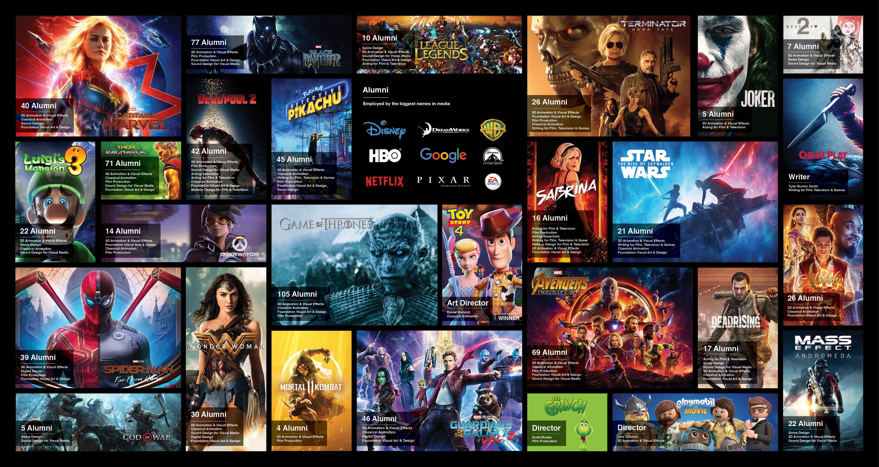
Study 2
Goal
To evaluate our taxonomy across VR apps.
Procedure
We used our taxonomy to analyze sounds in 33 VR apps across different genres (e.g., games, travel, art, media, fitness).
Eight HCI researchers used and classified sounds in these apps using our taxonomy.
Notes:
[pause] with a goal of [slide] evaluating our taxonomy across VR apps.
We did this by [slide] using our taxonomy to analyze sounds in 33 VR across a variety of categories such as games, fitness, art. We recruited [slide] eight hearing HCI researchers who used and classified sounds in these VR apps using our taxonomy.
Let’s see what we found [slide]

Slide 31
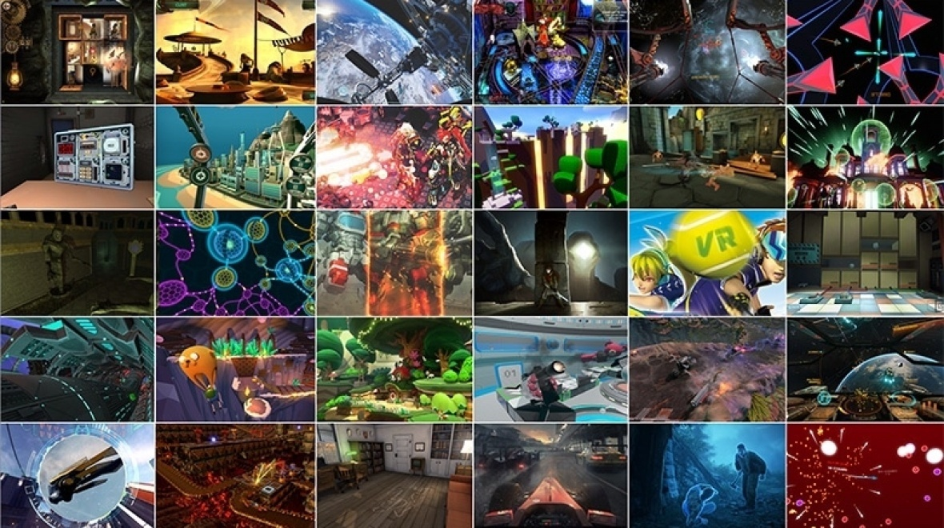
Study 2 Findings
Our taxonomy was able to cover nearly all sounds (265/267) in the 33 VR apps.
For two sounds that were not covered, little confusion arose among “surrounding ambience” and “music” categories.
We also identified what sounds categories are important to represent accessibly and how to develop visual and haptic substitutes for these sounds.
Notes:
[Pause] The primary finding was that [slide] our taxonomy was able to cover nearly all sounds encountered in the apps. The [slides] two sounds that were not covered was due to a little confusion among “surrounding ambience” or “music”. [don’t slide] The difference is that surrounding ambience are sounds that originate from objects inside the VR world, while music is a background noise,… which we should have made more clear in our evaluation. Beyond our taxonomy findings, [slide] we also identified [what sounds categories are important to represent accessibly and how we can develop visual and haptic substitutes for them,… which are described in the paper.
[pause] So.. [slide]

Slide 32
Reflections
Notes:
In summary, [pause]

Slide 33
Contributions
1
A novel taxonomyy to articulate both the source and the intent of VR sounds
Additional insights on sound design and sound accessibility in VR
2
Notes:
Our work contributes: [pause]
[slide] A novel taxonomy to articulate both the source and intent of sounds in VR, and
[slide] Additional insights from two studies on sound design and sound accessibility in VR

Slide 34
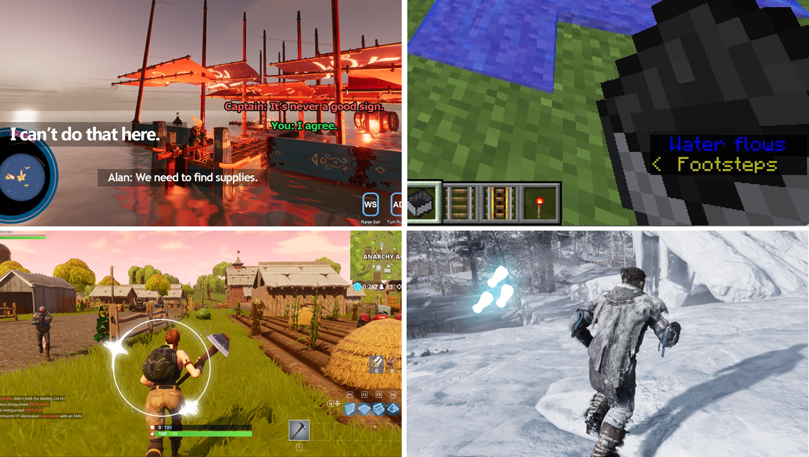
Further Work
We have a follow up paper that leverages our taxonomy to build and evaluate VR sound accessibility prototypes for DHH users.
Our taxonomy can help sound designers organize sounds in VR.
Our findings can benefit hearing users as well (e.g., situational impairments).
Our work can also potentially support other disabilities (e.g., sensory overload).
Notes:
[pause] So, where do we go from here?
[slide] We have an immediate follow up work in another paper, which leverages our taxonomy to build and evaluate several VR sound accessibility prototypes for DHH users. So, check it out.
[don’t slide] Also, though we targeted accessibility for DHH users, our taxonomy can be broadly used. For example, [slide] our taxonomy can also help sound designers organize sounds in VR, and maybe it could help them invent new sound effects. [slide] Our findings can also benefit hearing users as well-for example, there may be cases when you may not be wearing headphones while using VR in which case, you may want to have alternative feedback modality. And finally, [slide] our work can potentially support other disabilities such as those prone to sensory overload.
To conclude, I'd like to leave you with a statement, which my mentor Merrie Morris described so well. [slide]

Slide 35
Too often, accessibility is an afterthought.
VR technology is at a time when we can codify accessibility best-practices.
In this talk, I have presented the first comprehensive look at sounds in VR.
…with a goal of supporting sound accessibility for DHH end-users.
Notes:
Too often, accessibility is considered as an afterthought while making technologies, resulting in inaccessible or sub-par user experiences. [slide] VR technologies are at a crossroads in time where there is still an opportunity to codify accessibility best-practices for this emerging medium.
[slide] In this talk, I have presented the first comprehensive look at sounds in VR [slide]
…with a goal of supporting sound accessibility for DHH end-users. And we hope that [slide]

Slide 36
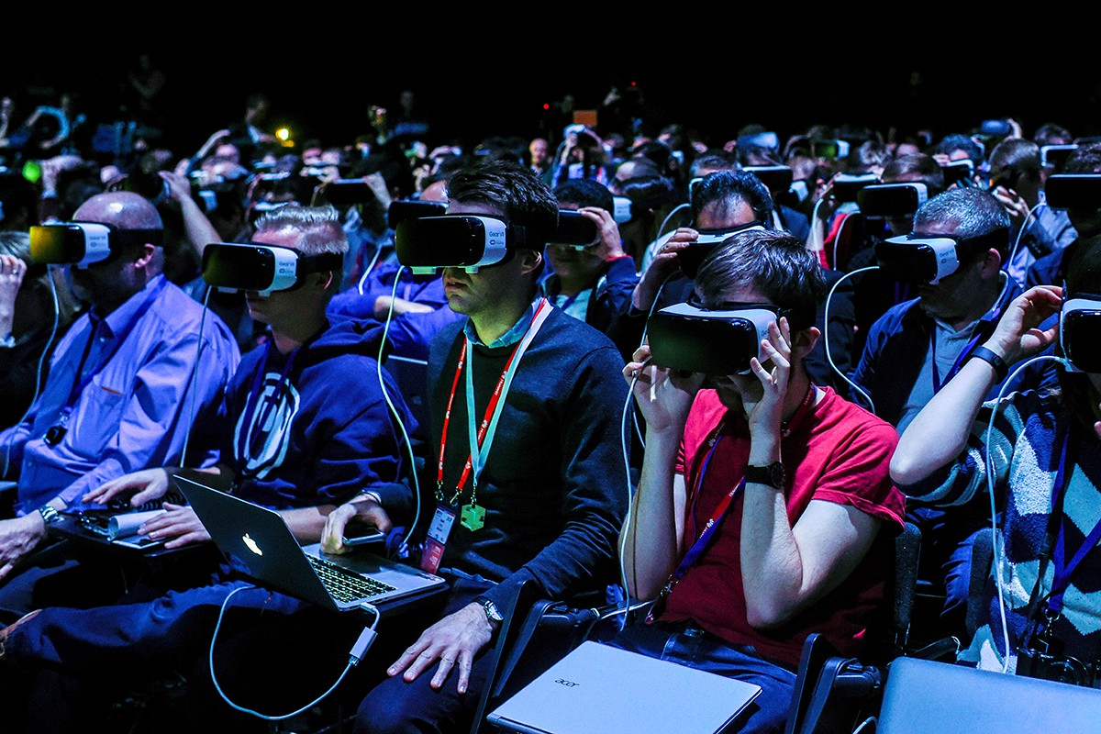
Calling out to VR researchers and practitioners!
Let’s continue to enhance sound accessibility in VR by spreading awareness, developing guidelines, and innovating accessible interfaces.
Notes:
researchers and practitioners will [slide] continue to enhance sound accessibility in VR by spreading awareness, developing guidelines, and innovating accessible interfaces.
Thank you.

